Slide 1
DevOps
A Walk through

Slide 2
What is DevOps?

Slide 3

“DevOps is development and operations collaboration”
“DevOps is treating your infrastructure as code”
It’s DevOps!
It’s DevOps!
“DevOps is using automation”
It’s DevOps!
“DevOps is feature switches”
It’s DevOps!
“Kanban for Ops?”
“DevOps is small deployments”

Slide 4
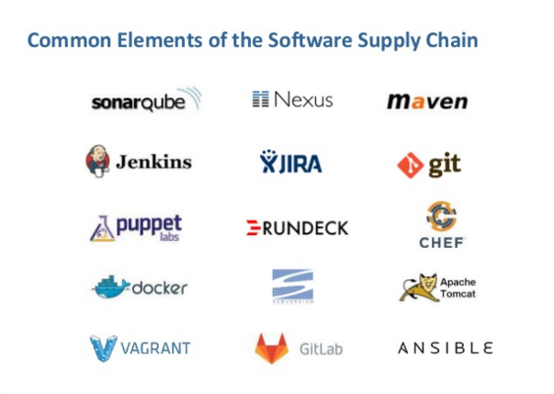

Slide 5
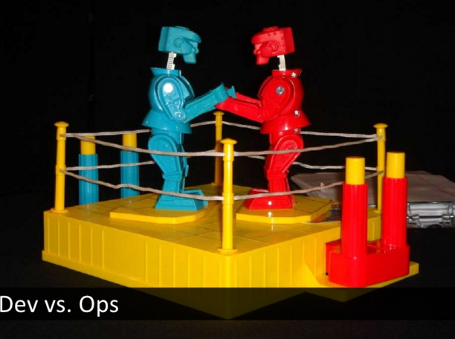
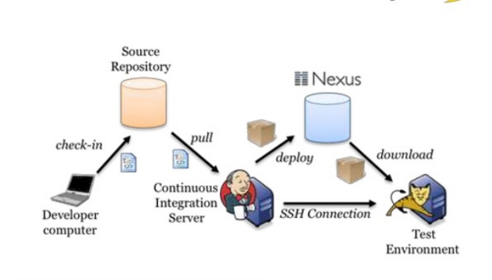

Slide 6
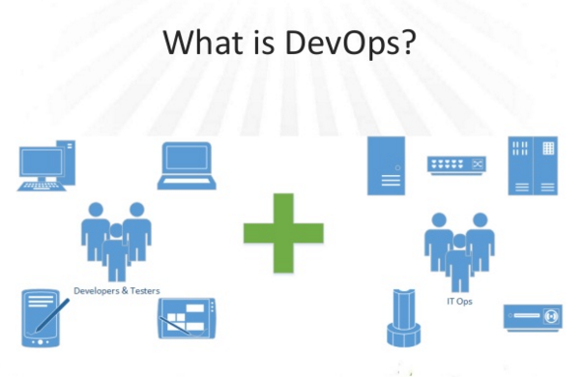

Slide 7
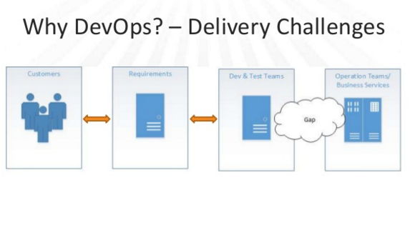

Slide 8
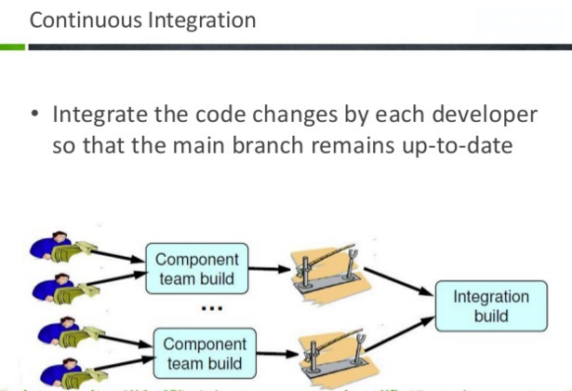

Slide 9
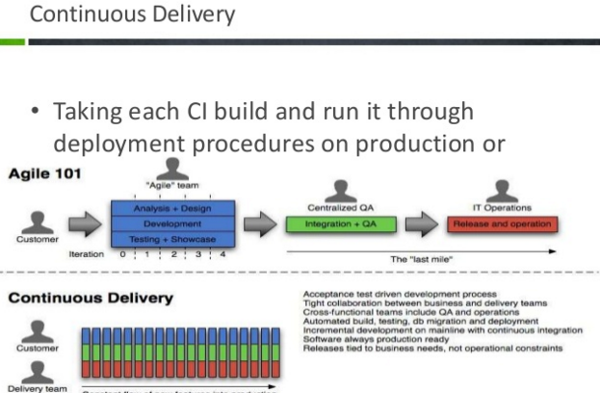

Slide 10
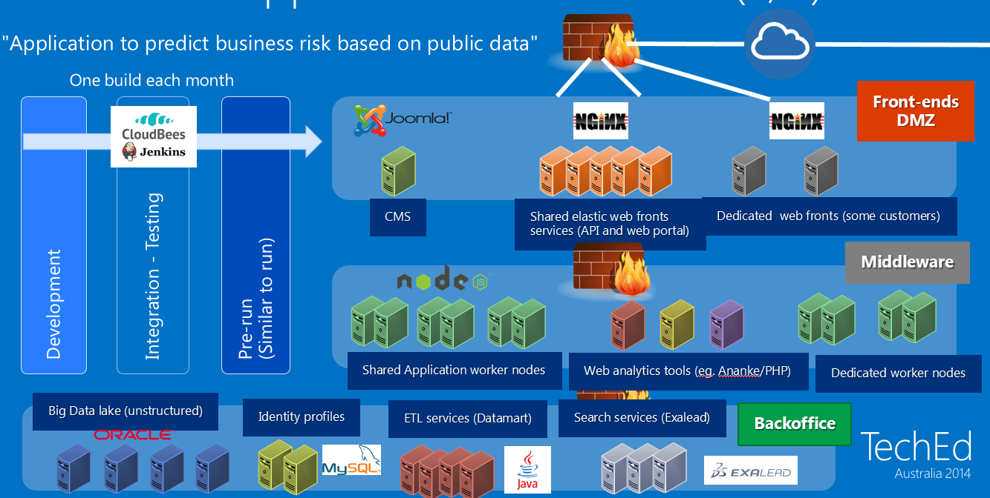
A Sample Future Application Stack

Slide 11
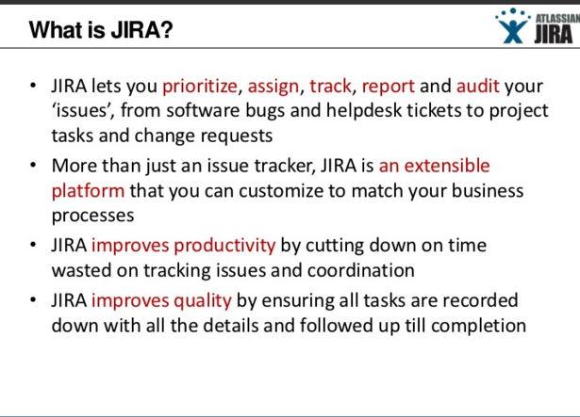
JIRA

Slide 12
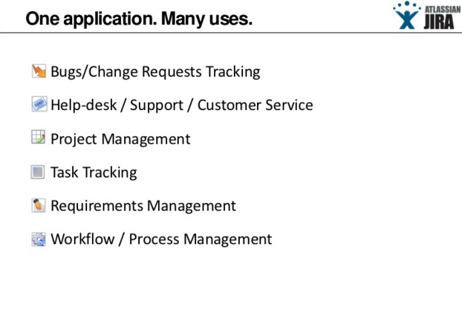

Slide 13
Version Control
Github
GitLab
BitBucket
Gitblit

Slide 14
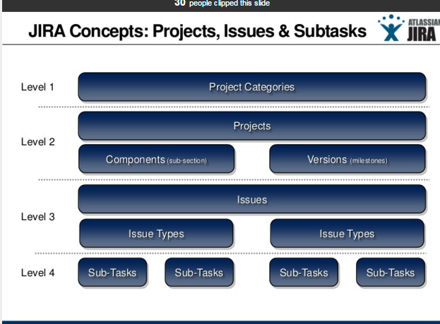

Slide 15
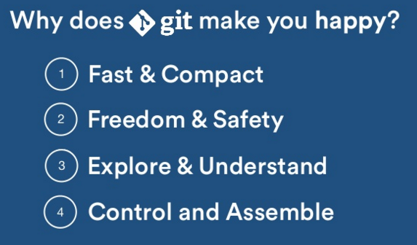
Git

Slide 16
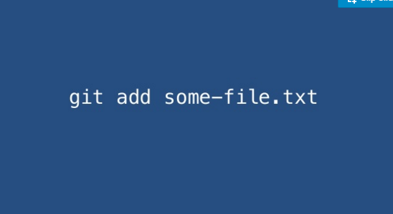

Slide 17
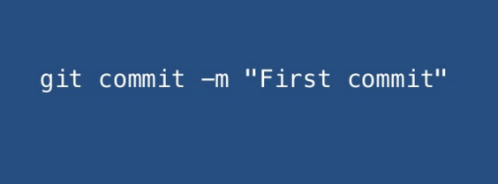

Slide 18
Build Tools
Maven
Gradle
Grunt
MSBuild
Ant
Make

Slide 19
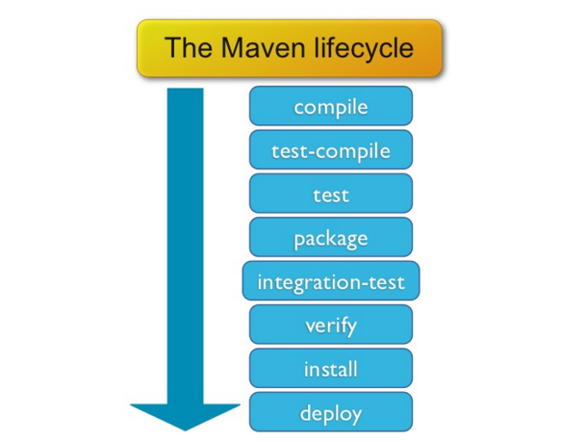
Maven

Slide 20
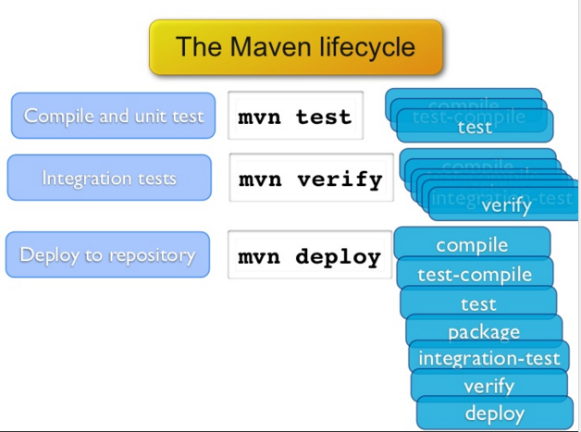
Maven..continued

Slide 21
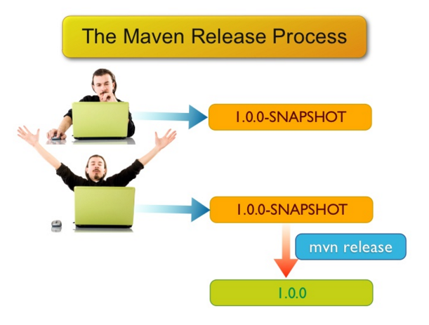
Maven..continued

Slide 22
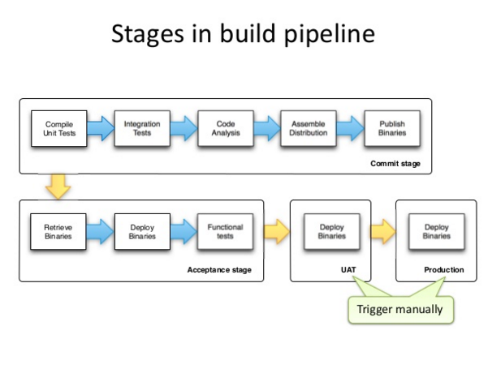

Slide 23
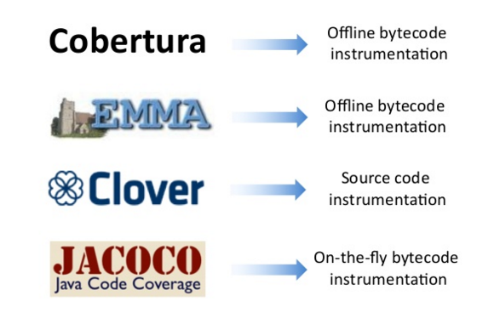
Code coverage

Slide 24
CI Tools
Jenkins
Bamboo
TravisCI

Slide 25
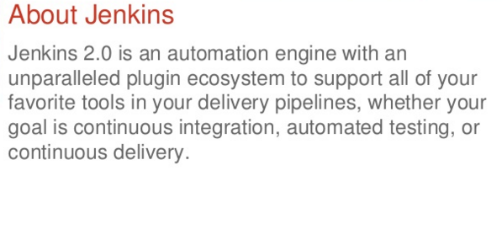
Jenkins

Slide 26
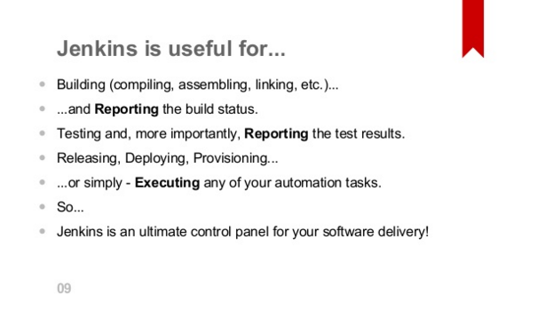
Jenkins..Continued

Slide 27
Static Code Analysis
There are seven technical axes that should be looked at when doing source code analysis of a project and Sonar is able to support the management of all seven. In the Sonar team, we like to call them the 7 deadly sins of the developer:
non respect of coding standards and best practices
lacking comments in the source code, especially in public APIs
having duplicated lines of code
having complex component or/and a bad distribution of complexity amongst components
having no or low code coverage by unit tests, especially in complex part of the program
leaving potential bugs
having a spaghetti design (package cycles…)

Slide 28
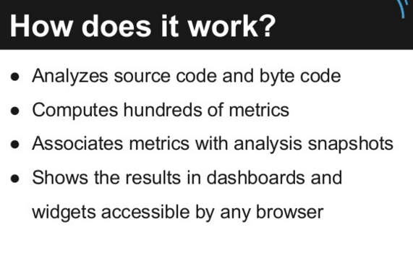
Sonarqube

Slide 29
Code Review
Gerrit
Revieboard
Barkeep

Slide 30
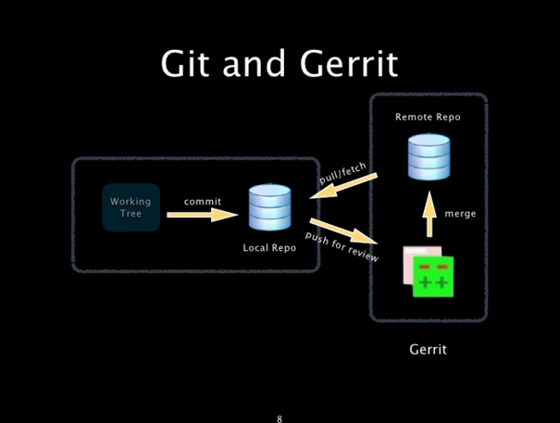

Slide 31
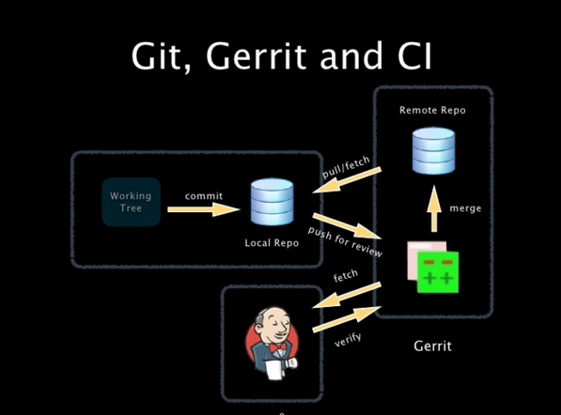

Slide 32
Artifact Repository
Nexus
Artifactory

Slide 33
Nexus
"Nexus is a repository manager. It allows you to proxy, collect, and manage your dependencies so that you are not constantly juggling a collection of JARs. It makes it easy to distribute your software. Internally, you configure your build to publish artifacts to Nexus and they then become available to other developers. You get the benefits of having your own 'central', and there is no easier way to collaborate."

Slide 34
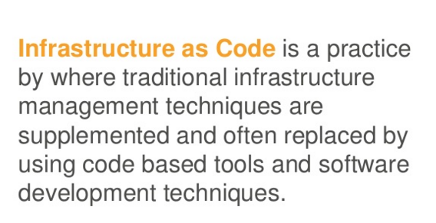
Infrastructure As Code

Slide 35
Tools
Ansible
Chef
Puppet
Saltstack
Terraform
Powershell DSC

Slide 36
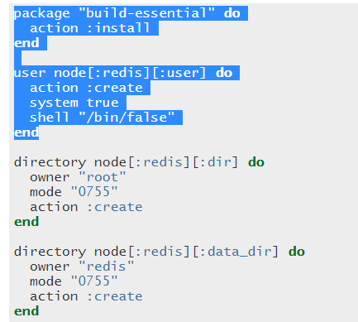
Sample Chef recipe:

Slide 37
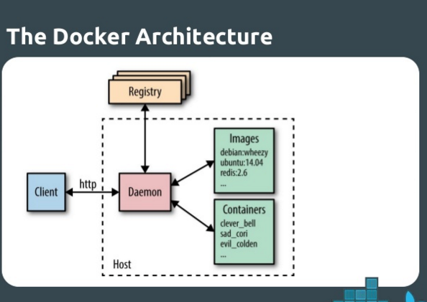
Docker

Slide 38
Containerization
Docker
LXC
Rocket

Slide 39
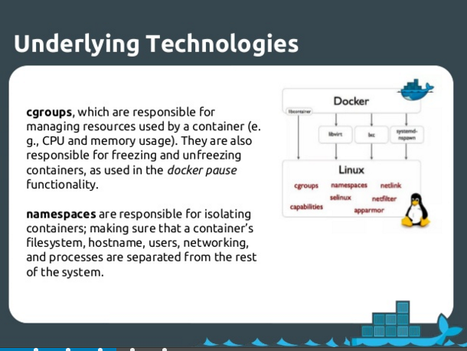

Slide 40
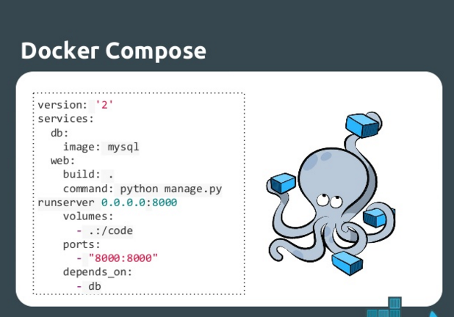

Slide 41
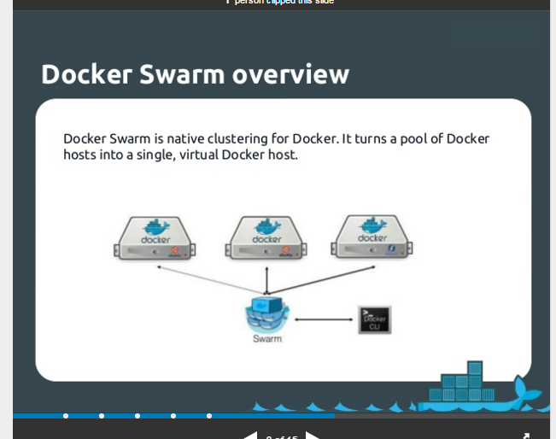
Container Orchestration

Slide 42
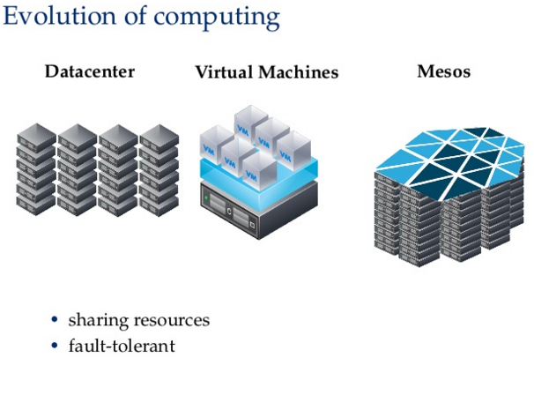
Datacenter Operating System

Slide 43
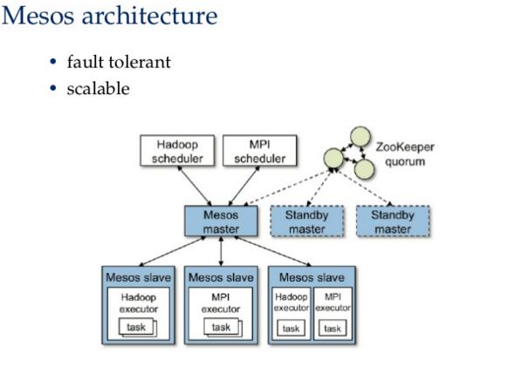

Slide 44
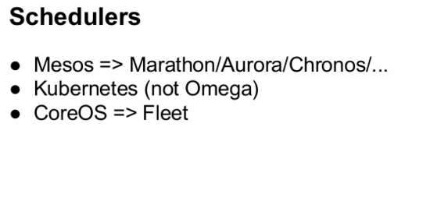

Slide 45
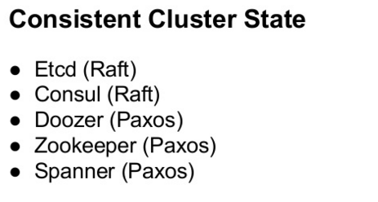

Slide 46
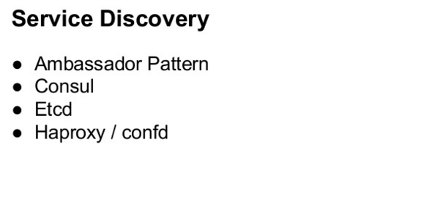

Slide 47
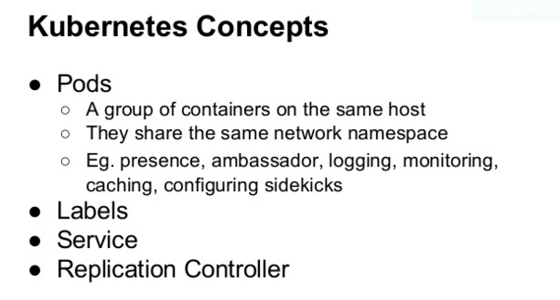
Kubernetes

Slide 48
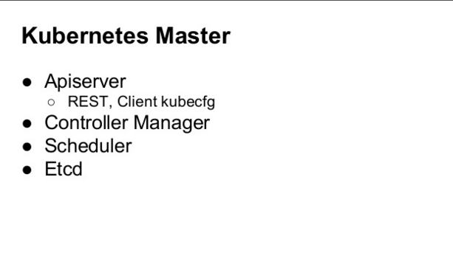

Slide 49
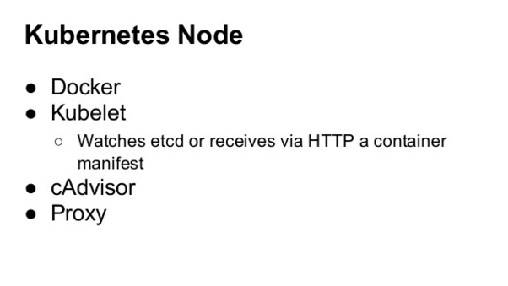

Slide 50
Micro services
Microservices is a software architecture style in which complex applications are composed of small, independent processes communicating with each other using language-agnostic APIs.

Slide 51
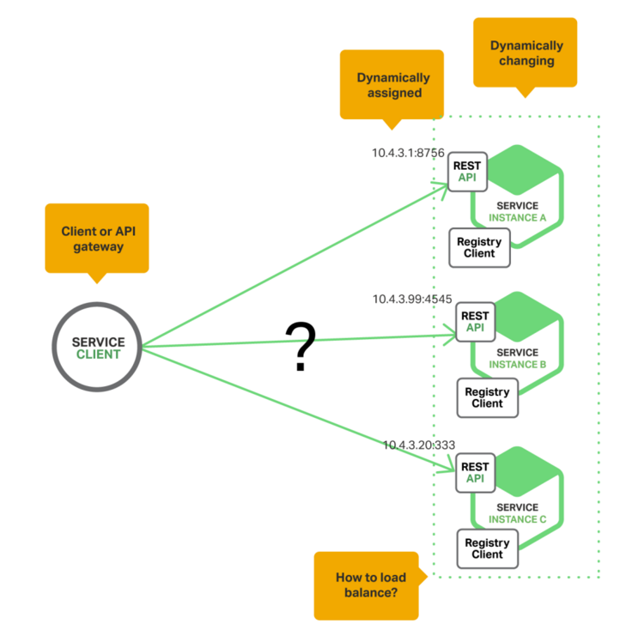
Service discovery

Slide 52
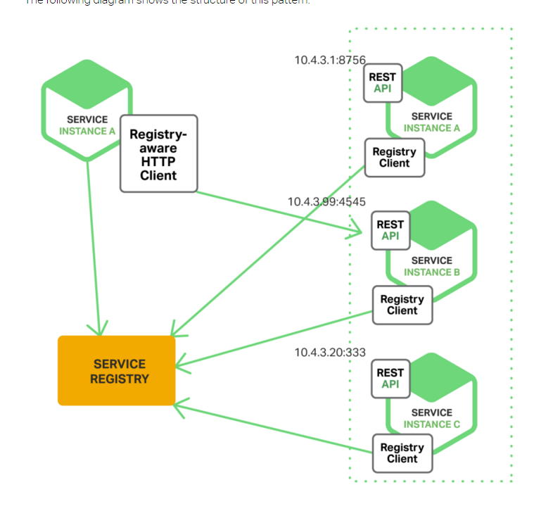
Service discovery..continued

Slide 53
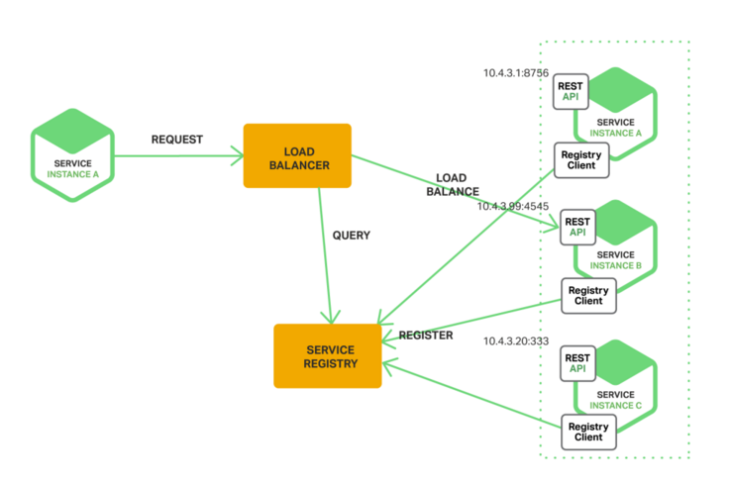
Service discovery..continued

Slide 54
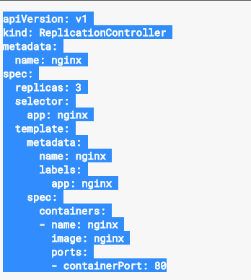
Kubernetes – Replication Controller

Slide 55
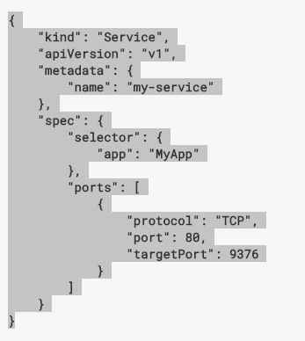
Kubernetes – Service Definition

Slide 56
Monitoring
Infrastructure Monitoring
Sensu
Nagios
Monit
Application Monitoring
Log monitoring
ELK
Splunk
Greylog
Container monitoring
cAdvisor

Slide 57
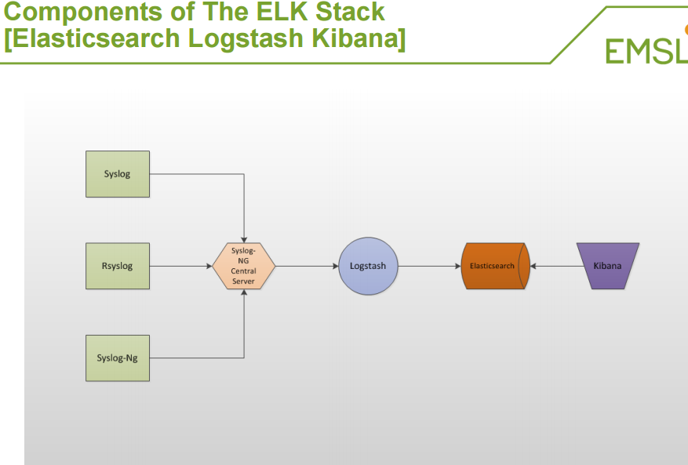
ELK Stack

Slide 58
Sample Log stash Configuration File
input { stdin { } }
filter
{
grok
{ match => { "message" => "%{COMBINEDAPACHELOG}" } } date { match => [ "timestamp" , "dd/MMM/yyyy:HH:mm:ss Z" ] }
}
output
{ elasticsearch { hosts => ["localhost:9200"] } stdout { codec => rubydebug }
}

Slide 59
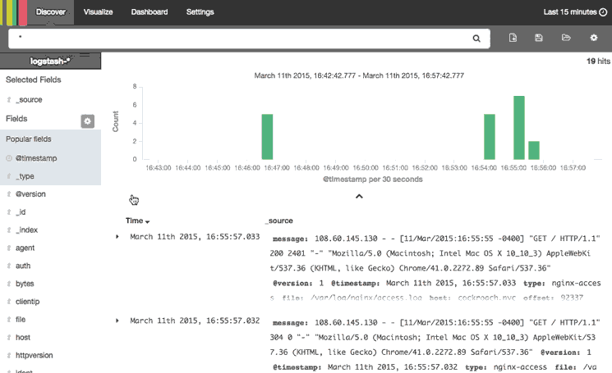
Kibana

Slide 60
Cloud
Public
Private
Hybrid

Slide 61
AWS (Amazon Web services)
VPC
EC2
ELB
S3
EBS
ASG
RDS
CloudFront
Route 53

Slide 62
Questions?

